Slide 1
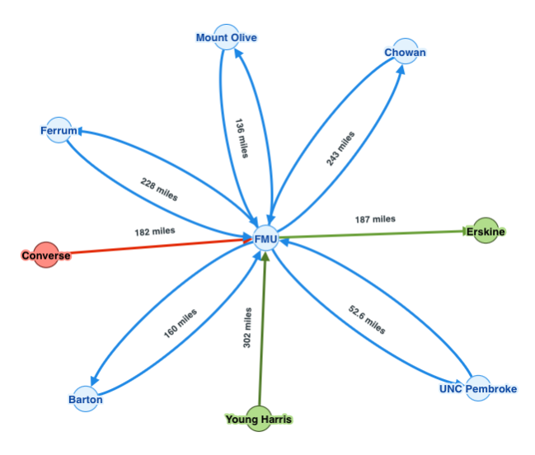
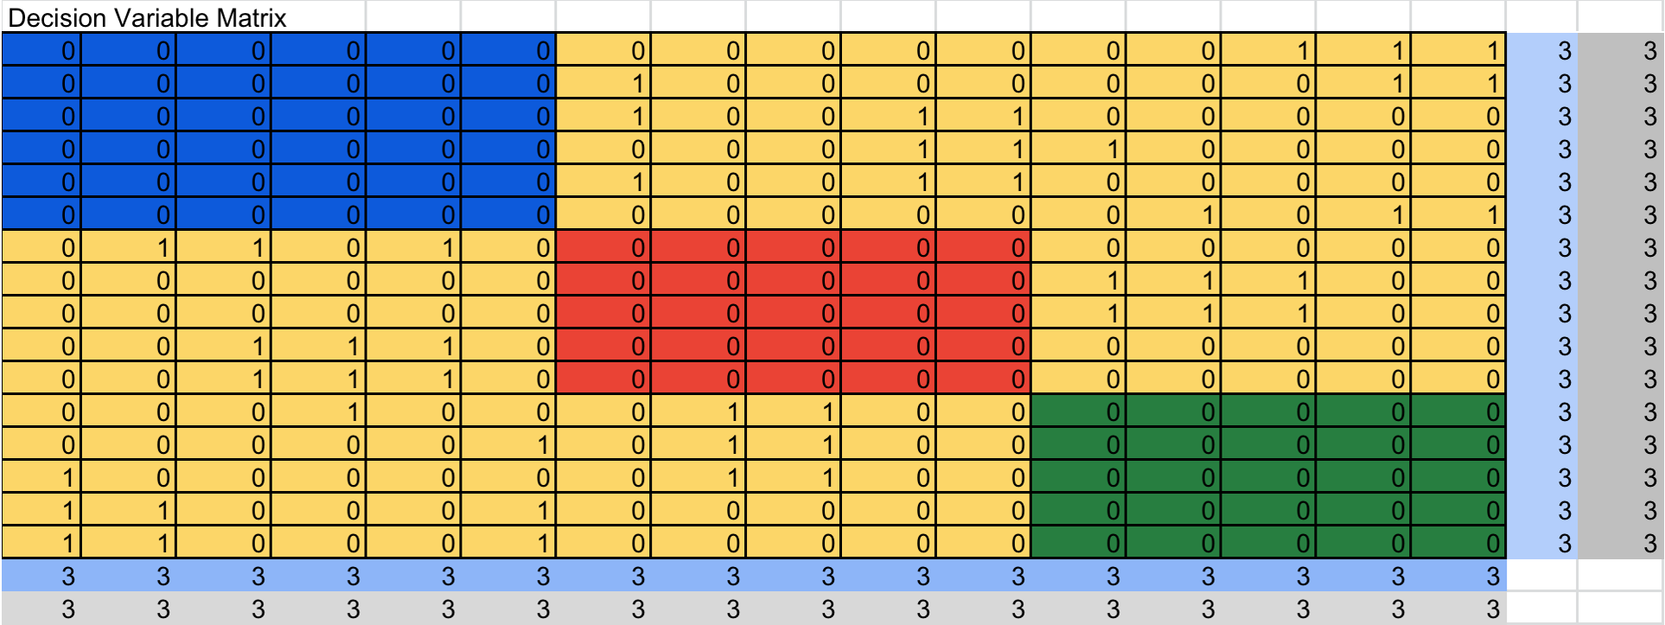
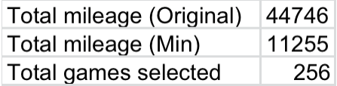
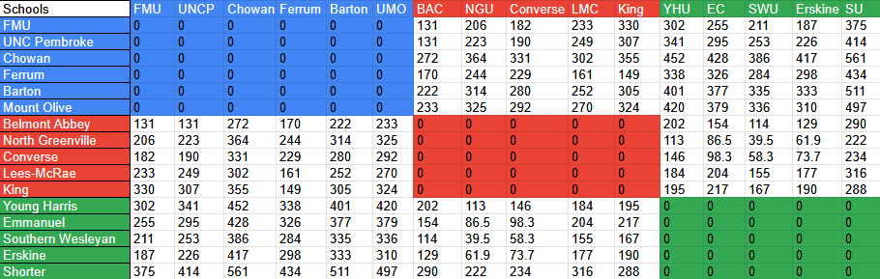

Optimizing FMU Women’s Soccer Conference Carolina’s Schedule Using Graph Theory and Linear Programming
Researcher: Tauzhanee Spann Research Advisor: Dr. Thomas Fitzkee
Abstract:
This project addresses inefficiencies in the 2025–2026 Francis Marion University’s Women’s Soccer schedule, where teams travel separately and play on different days, increasing costs. Using graph theory, the branch and bound method, and linear programming with a matrix-based objective function, the model minimizes travel and improves coordination while maintaining a balanced round-robin schedule.
Background on Data Set:
The dataset consists of travel distances between Conference Carolinas women’s soccer teams. Each team represents a node, and the distance between schools represents weighted edges in a graph. The focus is on non-division matchups, where not all teams are required to play each other, creating an uneven scheduling problem. A distance matrix was constructed to store mileage between each pair of teams, which serves as the foundation for the optimization model.
Background on Software/Hardware:
This project uses OpenSolver, an open-source extension of Excel that enables large-scale optimization beyond the limits of the built-in Excel Solver. Due to the size of the decision matrix and number of constraints, Excel Solver was not sufficient. OpenSolver allows for significantly more variables and constraints and uses advanced algorithms (such as linear programming solvers and Branch and Bound methods) to compute optimal solutions efficiently.
Background on Models Used:
Describe models used.
This project combines Graph Theory and Linear Programming
Graph Theory:
The conference is modeled as a weighted graph where:
Nodes = teams
Edges = travel distances
A star graph structure is used to simplify visualization.
Linear Programming Model: The objective function minimizes total travel distance: Z = total mileage
Integer Programming (Branch and Bound):Since games are either scheduled or not (0 or 1), binary decision variables are required. Branch and Bound ensures only whole-number solutions are considered.
Describe Methodology:
Constructed a Graph for 2025-2026 Women's Soccer Conference Carolinas Games
Constructed a distance matrix of all teams
Defined decision variables using a 16 × 16 decision matrix
Created an objective function:
Minimize total travel distance using SUMPRODUCT(DistanceMatrix,DecisionMatrix)
Applied constraints:
Teams play a limited number of non-division games
No duplicate or invalid matchups
Used OpenSolver with Branch and Bound to compute the optimal schedule
Results:
The optimized model successfully minimized total travel distance for non-division games while satisfying all scheduling constraints. The use of Solver produced an efficient schedule that reduces unnecessary travel, demonstrating how mathematical optimization can improve real-world sports scheduling.
Conclusion:
Optimization improves scheduling efficiency
Travel distance can be minimized using mathematical models
Graph theory provides structure for the problem
Linear programming determines the best solution
Solver and Branch & Bound ensure optimal results
Future work:
Love to do it for all the sports at FMU
incorporate Actuarial Sciences into it one days
Citations:
https://www.numberanalytics.com/blog/graph-theory-fundamentals-beginners-guide
https://www.cuemath.com/algebra/objective-function/
https://support.microsoft.com/en-us/office/define-and-solve-a-problem-by-using-solver-5d1a388f-079d-43ac-a7eb-f63e45925040
https://en.wikipedia.org/wiki/Branch_and_bound
Acknowledgements:
Sponsor: Dr. Thomas Fitzkee
Mr. Phillips (Linear Programming)
Savannah Bailey, Furman University Linear Programming in ACC Women’s Basketball at NCUWM
MYSELF

